Slide 1
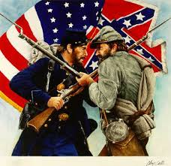
Chapter 16 “ The Civil War Begins”
16.2 “Life in the Army”
Pages 488- 492

Slide 2
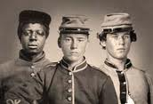
Those Who Fought
Most men were between the ages of 18 – 30 that fought in the two armies.
Each of the armies were made up with about 50% farmers.
Most of the men were born in the U.S. but immigrants such as the Germans and Irish served in large numbers.
African Americans served in the Union (2 million) and Confederate (1 million) troops.

Slide 3
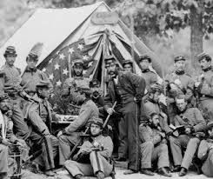
Turning Civilians into Soldiers
Enlistments were sent to camp to learn how to be a soldier.
They slept in tents in the summer and log hunts in the winter.
Recruits would elect company officers to lead their company.
The majority of their day was filled with drills, duties, and keeping camps clean.
Union soldiers had shoddy uniforms and shoes but the Confederacy wore their own clothes and sometimes removed clothing from the dead.
Over time soldiers on both sides received less rations of food.

Slide 4
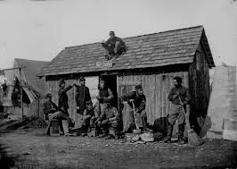
Hardships of Army Life
Soldiers were rarely dry and clean due to poor living conditions.
The men were often hungry and filthy covered with fleas and lice.
Poor hygiene habits allowed the spread of sickness rapidly.
Soldiers didn’t always have access to clean / fresh water.
Hospitals were breading grounds for disease.

Slide 5
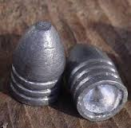
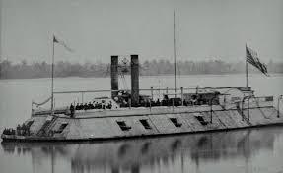
Changes in the Military Technology
Improvements in technology allowed the weapons to be used at a greater distance with accuracy.
Like the rifle and the minie ball
Ironclad, warships like the (C) Virginia and the (U) Monitor squared up, off the coast of Virginia in 1862 ending in a draw.

