Slide 1
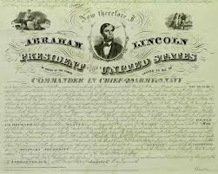
Chapter 17 “The Tide of War Turns”
17.1 Emancipation Proclamation

Slide 2
CAUSES AND EFFECTS OF THE EMANCIPATION PROCLAMATION
CAUSES
The E.P. would weaken the South’s economy.
After Lee (C) was stopped at Antietam, the nation (U) was in a position of strength.
Getting Congressional approval would be easier
Effects
Slaves were freed only in the Confederacy – NOT the border states
The Union soldiers had to be present in the South to enforce the E.P.
Tens of thousands of AA enlisted and serves in the Union army

Slide 3
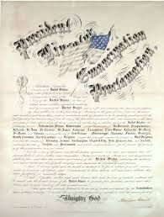
Emancipation Proclamation
ABOLITIONISTS
Abolitionists were thrilled by the Emancipation Proclamation, though many believed that Lincoln should have done more to free all of the enslaved.

Slide 4
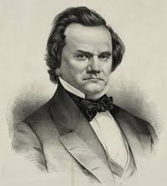
Emancipation Proclamation
NORTHERN DEMOCRATS
Northern Democrats were against the Emancipation Proclamation because they thought it would anger the Southerners and prolong the war.

Slide 5
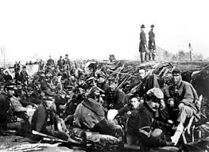
Emancipation Proclamation
UNION SOLDIERS
Union soldiers welcomed the Emancipation Proclamation because it weakened the rebels (Southerners).

Slide 6
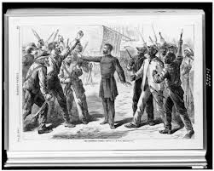
Emancipation Proclamation
WHITE SOUTHERNERS
White southerners were enraged by the Emancipation Proclamation.
They believed that Lincoln had no business to write a law that would effect the Confederacy.

Slide 7
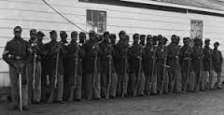
Emancipation Proclamation
BLACK SOUTHERNERS
African Americans would be welcomed into the Union armies.
African Americans served by the tens of thousands.
Many black southerners began to flee the south to serve in the Union army.

