Slide 1
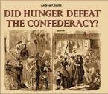
Chapter 17 “The Tide of War Turns”
17.2 “War Affects Society”

Slide 2
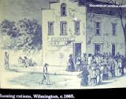
Economic Changes
Farmers left their farms to serve in the war.
Food shortages were common.
Food distribution was difficult because the trains were transporting soldiers and supplies.
Inflation was a problem in the North, but it was severe in the South.
An income taxes and greenbacks (paper money) were introduced in the North.
Enslaved workers hurt the Southern economy through sabotage and desertion.

Slide 3
Social and Political Changes
Lincoln repealed Habeas Corpus to curb dissent in the North.
Conscription (draft) laws were passed in the North and the South to serve in the armies.
Women assumed increased responsibility in both the North and the South at home and the workplace.

Slide 4
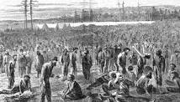
Conditions of Civil War Prison Camps
Exposure to severe weather conditions in the North and South.
Disease spread rapidly due to poor sanitation.
Prison had severe overcrowding with prisoners of war in the North and the South.
Prisons had inadequate supplies of food and water.

